Slide 1


BCSAIMLcs/bcaaiml
Semester-IV
Paper Code – BCSAIML403 & BCAAIML402
Cloud Computing and its security
Ms. Anjali Goswami
Assistant Professor
Faculty of CSIT
Kalinga University
Naya Raipur (C.G.), India

Slide 2
BCSAIMLcs/bcaaiml
Semester-IV
Paper Code – BCSAIML403 & BCAAIML402
Cloud Computing and its security
Unit - 3

Slide 3
Confidentiality, Integrity, Availability, Authenticity, and Non-repudiation (often abbreviated as "CIA" or "CIAAN") are the five core security properties that are used to ensure the security and reliability of information systems. Together, they form the foundation of information security and are the key elements that must be protected in order to ensure the safe and secure handling of sensitive information.
Confidentiality is important to protect sensitive information from being disclosed to unauthorized parties. This includes protecting data at rest, in transit, and in use. Common techniques used to maintain confidentiality include encryption, access controls, and data masking.
Integrity is important to ensure that information has not been tampered with or modified in an unauthorized way. This includes protecting data from unauthorized modification, deletion or addition. Common techniques used to maintain integrity include digital signatures, message authentication codes, and data hashing.
Availability is important to ensure that information and systems are accessible to authorized users when they need them. This includes protecting against denial of service attacks and ensuring that systems are highly available and can withstand failures. Common techniques used to maintain availability include load balancing, redundancy, and disaster recovery planning.

Slide 4

4. Authenticity is important to ensure that information and communication come from a trusted source. This includes protecting against impersonation, spoofing and other types of identity fraud. Common techniques used to establish authenticity include authentication, digital certificates, and biometric identification.
5. Non-repudiation is important to ensure that a party cannot deny having sent or received a message or transaction. This includes protecting against message tampering and replay attacks. Common techniques used to establish non-repudiation include digital signatures, message authentication codes and timestamps.

Slide 5
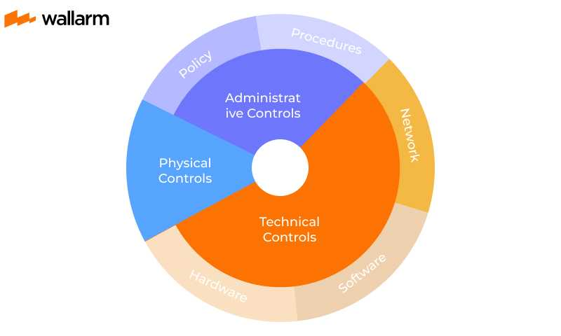
Why is Defense in Depth Important?
As the outcome of a successful cyber threat can be too detrimental, experts consider having various approaches in place. A single product is not enough to encounter every attack and danger around us.
With DiD concept, it’s easy and possible to deploy more than one cybersecurity measure for your systems, eliminating all the odds of security failures and threat penetrations.
If one security measure fails, by any chance, another comes into effect and protects the resources. So, network security is better and follows redundancy when DiD is at work.

Slide 6
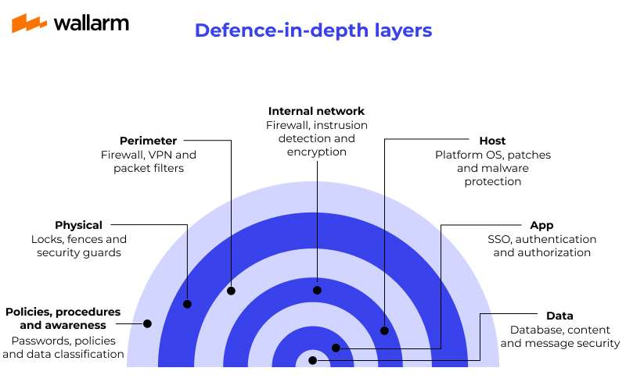

Slide 7
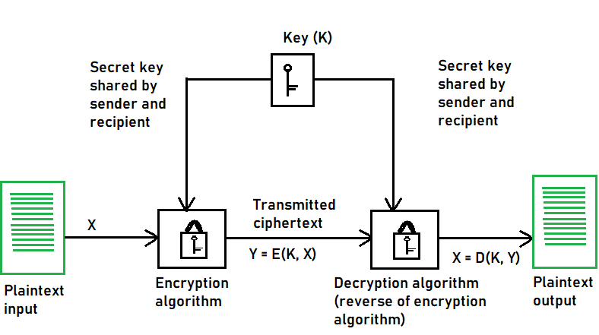
Symmetric Key Cryptography
Symmetrical Key Cryptography also known as conventional or single-key encryption was the primary method of encryption before the introduction of public key cryptography in the 1970s.
In symmetric-key algorithms, the same keys are used for data encryption and decryption. This type of cryptography plays a crucial role in securing data because the same key is used for both encryption and decryption.

Slide 8
Transposition Techniques
Transposition techniques rearrange the order of elements in the plaintext message without changing the elements themselves.
Rail Fence Cipher: This is a simple cipher that rearranges the elements by writing the plaintext message in a zigzag pattern, with the different components written in rows (rails) of an imaginary fence and then reading through the columns in a standard order. The key to this is the number of rails used.
Columnar Transposition: In the case of a plaintext message written in columns and then the columns rearranged according to a permutation determined by the key, this cipher is known as columnar transposition. Although it is still vulnerable to cryptanalysis techniques that exploit the statistical properties of the language.

Slide 9
Block Cipher modes of Operation
Encryption algorithms are divided into two categories based on the input type, as a block cipher and stream cipher. Block cipher is an encryption algorithm that takes a fixed size of input say b bits and produces a ciphertext of b bits again. If the input is larger than b bits it can be divided further. For different applications and uses, there are several modes of operations for a block cipher.
Electronic Code Book (ECB) –
Electronic code book is the easiest block cipher mode of functioning. It is easier because of direct encryption of each block of input plaintext and output is in form of blocks of encrypted ciphertext. Generally, if a message is larger than b bits in size, it can be broken down into a bunch of blocks and the procedure is repeated.

Slide 10
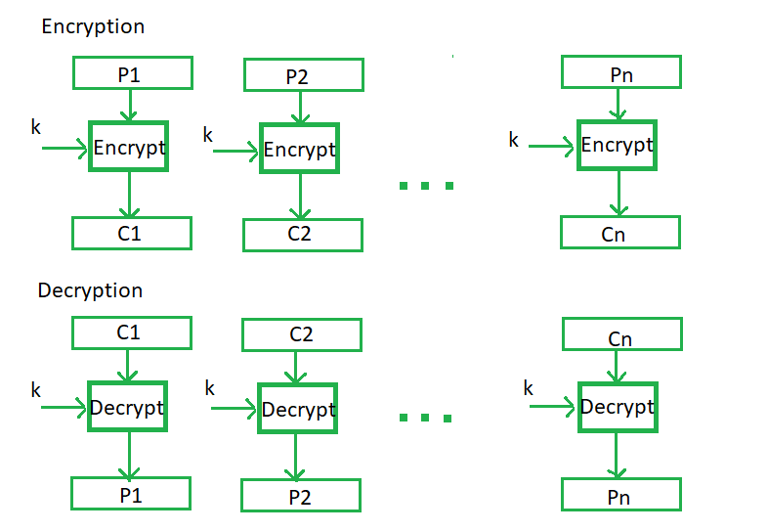
Procedure of ECB is illustrated below:

Slide 11
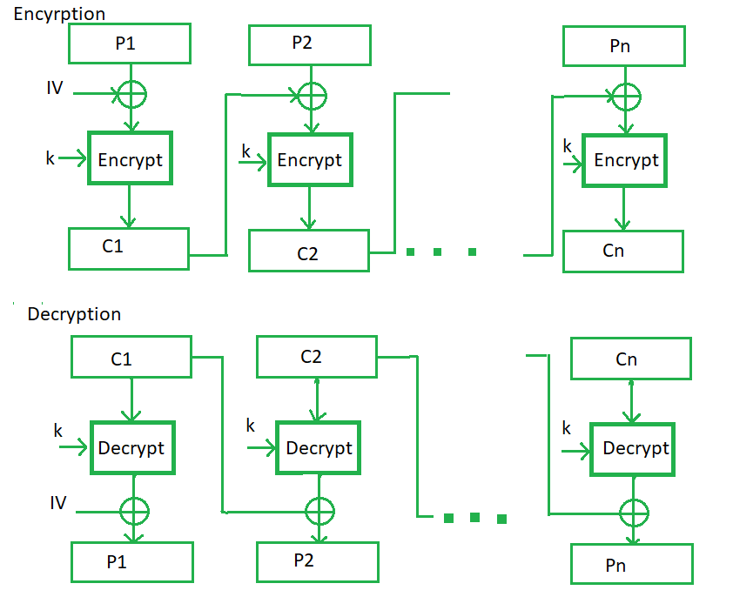
Cipher Block Chaining –
Cipher block chaining or CBC is an advancement made on ECB since ECB compromises some security requirements. In CBC, the previous cipher block is given as input to the next encryption algorithm after XOR with the original plaintext block. In a nutshell here, a cipher block is produced by encrypting an XOR output of the previous cipher block and present plaintext block.

Slide 12
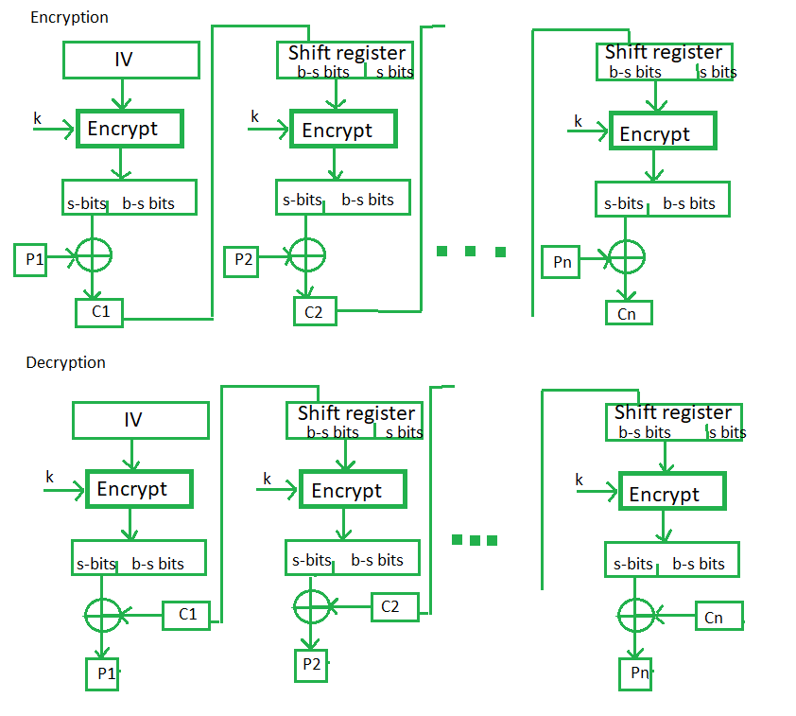
Cipher Feedback Mode (CFB) –
In this mode the cipher is given as feedback to the next block of encryption with some new specifications: first, an initial vector IV is used for first encryption and output bits are divided as a set of s and b-s bits. The left-hand side s bits are selected along with plaintext bits to which an XOR operation is applied. The result is given as input to a shift register having b-s bits to lhs,s bits to rhs and the process continues. The encryption and decryption process for the same is shown below, both of them use encryption algorithms.

Slide 13
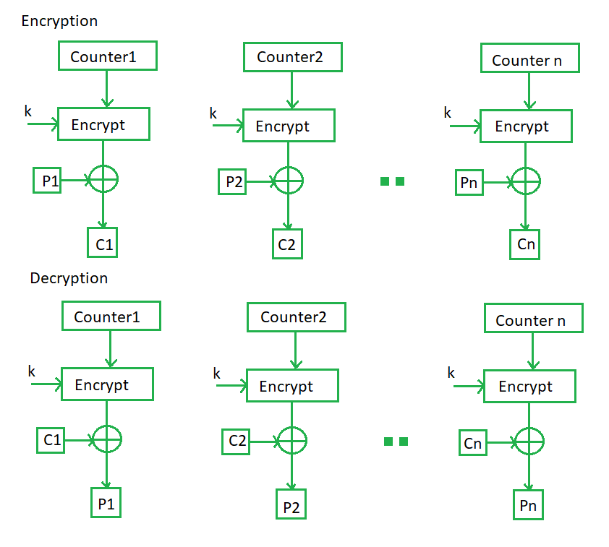
Counter Mode –
The Counter Mode or CTR is a simple counter-based block cipher implementation. Every time a counter-initiated value is encrypted and given as input to XOR with plaintext which results in ciphertext block. The CTR mode is independent of feedback use and thus can be implemented in parallel.
Its simple implementation is shown below:

Slide 14
Public Key Encryption
Public key cryptography provides a secure way to exchange information and authenticate users by using pairs of keys. The public key is used for encryption and signature verification, while the private key is used for decryption and signing.
When the two parties communicate with each other to transfer the intelligible or sensible message, referred to as plaintext, is converted into apparently random unreadable for security purposes referred to as ciphertext.
What is Public Key Cryptography?
Public key cryptography is a method of secure communication that uses a pair of keys, a public key, which anyone can use to encrypt messages or verify signatures, and a private key, which is kept secret and used to decrypt messages or sign documents.
This system ensures that only the intended recipient can read an encrypted message and that a signed message truly comes from the claimed sender.
Public key cryptography is essential for secure internet communications, allowing for confidential messaging, authentication of identities, and verification of data integrity.

Slide 15
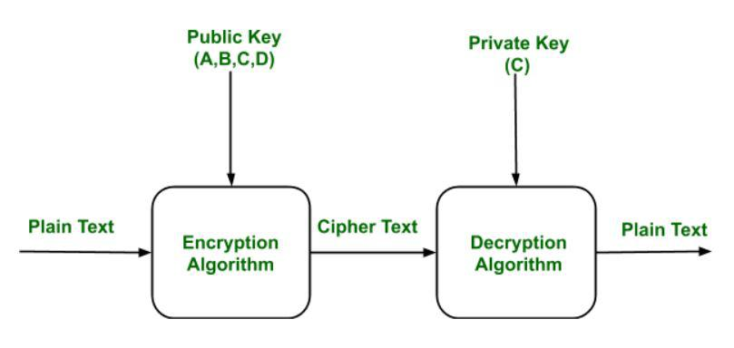
What is a Cryptographic Key?
A cryptographic key is a piece of information used by cryptographic algorithms to encrypt or decrypt data, authenticate identities, or generate digital signatures. It serves as a parameter to control cryptographic operations, ensuring the security and privacy of digital communications and transactions.

Slide 16
Components of Public Key Encryption
Plain Text: This is the message which is readable or understandable. This message is given to the Encryption algorithm as an input.
Cipher Text: The cipher text is produced as an output of Encryption algorithm. We cannot simply understand this message.
Encryption Algorithm: The encryption algorithm is used to convert plain text into cipher text.
Decryption Algorithm: It accepts the cipher text as input and the matching key (Private Key or Public key) and produces the original plain text
Public and Private Key: One key either Private key (Secret key) or Public Key (known to everyone) is used for encryption and other is used for decryption

Slide 17
Public Key Infrastructure
Public key infrastructure or PKI is the governing body behind issuing digital certificates. It helps to protect confidential data and gives unique identities to users and systems. Thus, it ensures security in communications.
The public key infrastructure uses a pair of keys: the public key and the private key to achieve security. The public keys are prone to attacks and thus an intact infrastructure is needed to maintain them.
Managing Keys in the Cryptosystem:
The security of a cryptosystem relies on its keys. Thus, it is important that we have a solid key management system in place. The 3 main areas of key management are as follows:
A cryptographic key is a piece of data that must be managed by secure administration.
It involves managing the key life cycle which is as follows:

Slide 18
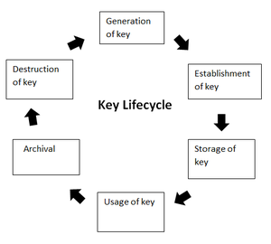

Slide 19
Public Key Infrastructure:
Public key infrastructure affirms the usage of a public key. PKI identifies a public key along with its purpose. It usually consists of the following components:
A digital certificate also called a public key certificate
Private Key tokens
Registration authority
Certification authority
CMS or Certification management system

Slide 20
How Hashing Algorithm Used in Cryptography?
A Hash Function (H) takes a variable-length block of data and returns a hash value of a fixed size. A good hash function has a property that when it is applied to a large number of inputs, the outputs will be evenly distributed and appear random.
Generally, the primary purpose of a hash function is to maintain data integrity. Any change to any bits or bits in the results will result in a change in the hash code, with a high probability.
The type of hash function that is needed for security purposes is called a cryptographic hash function.
A cryptographic hash function (or cryptographic hash algorithm) is an algorithm that is not computationally efficient (no attack is more efficient than brute force) when it is used to find either:
A data object which maps to a predefined hash result
Two data objects that map to the hash result in collision-free property.

Slide 21
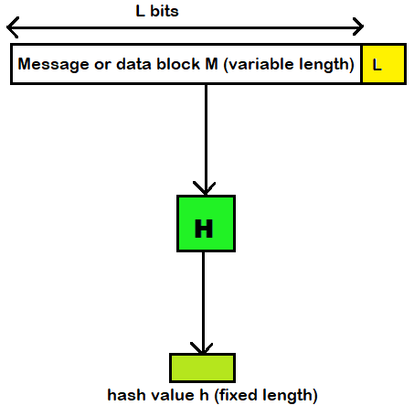
Because of these properties, a hash function is often used to check whether data has changed.

Slide 22
Digital Signatures
In the case of a digital signature, the hash value of a message is encrypted using the private key owned by the person sending it out so that no one else can change what they have said without being detected easily by those looking for it also within seconds by those scanning across different networks particularly corporate or government intranets.
With this information at hand, hackers always attempt hacking passwords and other security codes so that torrent downloaders from this work freely without facing any restrictions they may not be able to avoid under lawful circumstances.
A hash code is used to provide a digital signature as:
The hash code is encrypted with public-key encryption using the sender's private key. This provides authentication, but it also provides a digital signature because only the sender can have produced the encrypted hash code. In fact, this is what the digital signature technique is all about.
b. If you want both confidentiality and a digital signature, then you can encrypt the message plus the private-key encrypted hash code using a symmetrical secret key. This is a common technique.

Slide 23
Key Management in Cryptography
In cryptography, it is a very monotonous task to distribute the public and private keys between sender and receiver. If the key is known to the third party (forger/eavesdropper) then the whole security mechanism becomes worthless.
So, there comes the need to secure the exchange of keys. In this article, we will learn about key management, how Cryptographic Keys Work, Types of Key Management, and Key Management Lifecycle.
What is Key Management?
Key management refers to the processes and procedures involved in generating, storing, distributing, and managing cryptographic keys used in cryptographic algorithms to protect sensitive data. It ensures that keys used to protect sensitive data are kept safe from unauthorized access or loss.
Good key management helps maintain the security of encrypted information and is important for protecting digital assets from cyber threats. Effective key management is crucial for ensuring the confidentiality, integrity, and availability of encrypted information by securing cryptographic keys from unauthorized access, loss, or compromise.

Slide 24
X.509 Authentication Service
X.509 is a digital certificate that is built on top of a widely trusted standard known as ITU or International Telecommunication Union X.509 standard, in which the format of PKI certificates is defined.
X.509 digital certificate is a certificate-based authentication security framework that can be used for providing secure transaction processing and private information. These are primarily used for handling the security and identity in computer networking and internet-based communications.
Working of X.509 Authentication Service Certificate:
The core of the X.509 authentication service is the public key certificate connected to each user. These user certificates are assumed to be produced by some trusted certification authority and positioned in the directory by the user or the certified authority.
These directory servers are only used for providing an effortless reachable location for all users so that they can acquire certificates. X.509 standard is built on an IDL known as ASN.1. With the help of Abstract Syntax Notation, the X.509 certificate format uses an associated public and private key pair for encrypting and decrypting a message.

Slide 25
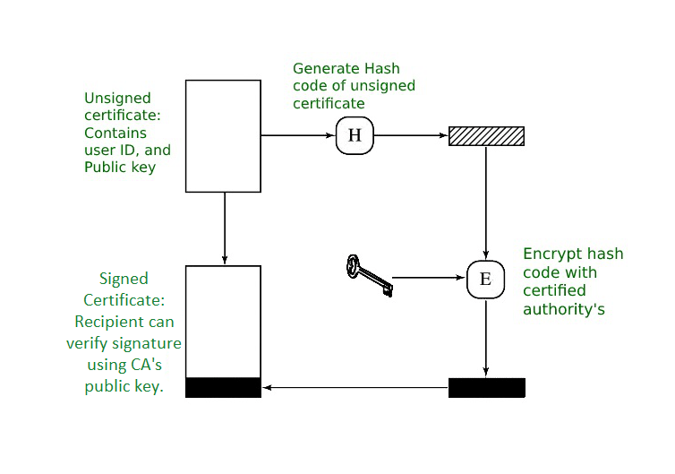

Slide 26
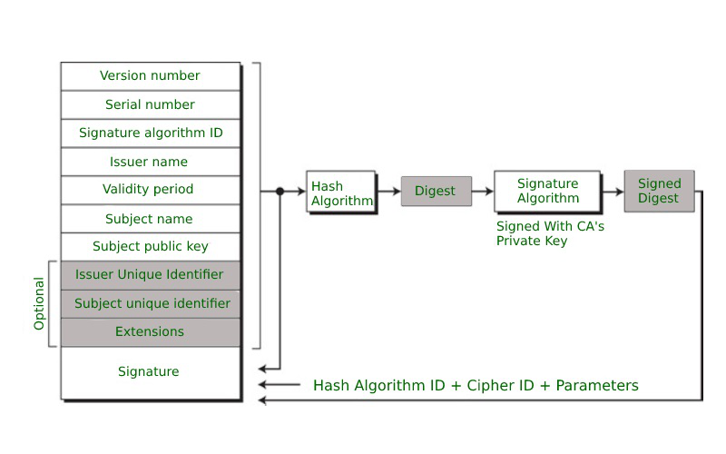
Format of X.509 Authentication Service Certificate:

Slide 27
Glossary: Cybersecurity Terms & Definitions
What Is OpenSSL?
OpenSSL is a cryptographic library that enables an open source implementation of Transport Layer Security (TLS) and Secure Sockets Layer (SSL) protocols. It provides functions to generate private keys, manage certificates, and equip client applications with encryption and decryption.
OpenSSL is widely used by software developers and system administrators to implement secure communication and encryption in various applications, such as web servers (like NGINX), email servers, VPNs, and more. It’s available as a library that can be integrated into software applications or used as standalone command-line tools for various cryptographic operations.

Slide 28
OpenSSL Use Cases for Secure Application Delivery
OpenSSL can play a crucial role in a secure application delivery strategy, particularly when it comes to ensuring the confidentiality, integrity, and authenticity of data transmitted over networks.
It is commonly used for these use cases:
Secure communication between clients and servers
Data encryption
Certificate management
Data integrity and authentication
Random number generation
Secure protocols and algorithms
Secure web server deployment

Slide 29
THANK YOU

